Slide 1
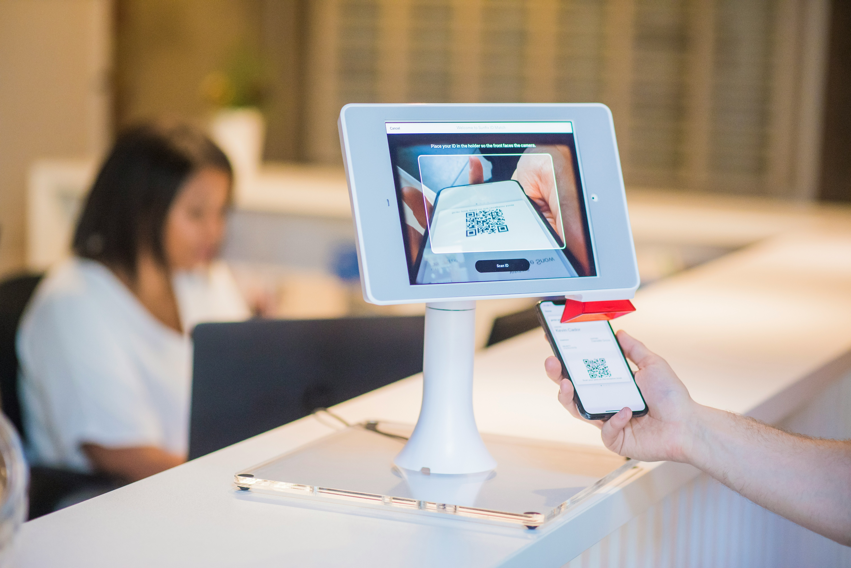
Visitor
Management
System
Team Members
Bevincent Edward E - 312321205030
Aakash G - 312321205003
Team Mentor
Ms.Divya J
Assistant Professor

Slide 2
Visitor Management System
Libraries & Models
Problem Statement
Abstract
Objectives
Workflow
User Interfaces
Literature Survey

Slide 3
Problem Statement
Inefficient and outdated visitor management processes pose significant security vulnerabilities and compliance risks for organizations. Manual sign-in procedures and lack of effective tracking systems not only jeopardize the safety of premises but also hinder regulatory compliance efforts. Moreover, the absence of scalable and integrated solutions further exacerbates these challenges, leading to inconsistent visitor experiences, delays, and productivity losses.
The consequences of non-compliant practices, whether due to outdated systems or inadequate processes, can result in legal liabilities and reputational damage. Addressing these issues requires a comprehensive overhaul of existing visitor management practices, including the implementation of modern digital solutions that prioritize security, efficiency, scalability, and compliance

Slide 4
Abstract
The Visitor Management System (VMS) serves as an integral component in modern organizational infrastructure, offering streamlined processes for visitor registration, tracking, and authentication
The Visitor Management System enhances security by accurately identifying authorized visitors and promptly identifying any anomalies. Integration with existing security infrastructure further strengthens the facility’s defense mechanisms, providing seamless access control and threat detection
The automated Visitor Management System represents a proactive approach towards enhancing security measures and operational efficiency within organizations. By leveraging cutting-edge technologies and intuitive interfaces, it empowers organizations to manage visitor access effectively, mitigate security risks, and streamline administrative processes.

Slide 5
Objectives
Enhance Security by Implementing robust security measures to effectively screen, monitor, and manage visitor access to premises, thereby reducing the risk of unauthorized entry or security breaches.
Improving the Visitor Experience by Providing an easy-to-use self-service kiosk, clear instructions, and minimal waiting periods, thus enhancing satisfaction and engagement.
Integrate with other security infrastructure, access control systems, and organizational databases for improved data accuracy and reduced duplication of efforts.

Slide 6
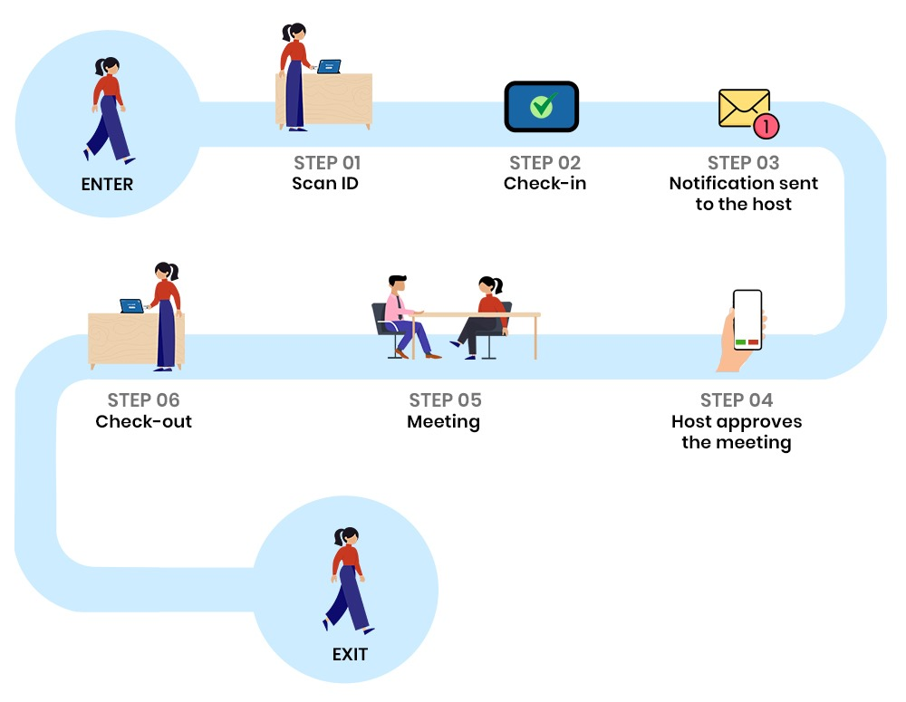
Workflow of VMS

Slide 7
Libraries & Algorithms
Flask is a micro web framework for Python used to build web applications.
OpenCV (Open Source Computer Vision Library) is an open-source computer vision and machine learning software library. In this code, it's used for image processing tasks such as face detection and recognition.
MongoDB is an open-source NoSQL database known for its flexibility and scalability. It stores data in JSON-like documents, enabling dynamic schema and high performance.
The Haar Cascade Classifier is an effective object detection method which uses Machine learning-based approach where a cascade function is trained from a lot of positive and negative images to detect objects, particularly faces, in images.
LBPH is a popular technique in the field of facial recognition. It works by analyzing the local structure of an image's texture. LBPH creates histograms of image patches, capturing the distribution of local binary patterns within each patch. This code uses LBPH for face recognition.

Slide 8
Literature Survey
Visitor Management System by Applying the Model of UTAUT
Norizan Anwar, Mohamad Noorman Masrek, Yanty Rahayu Rambli
Faculty of Information Management Universiti Teknologi MARA (UiTM) Selangor, Malaysia
COVID-19 Visitor Management System
Kartik Gautam, Amity University Uttar Pradesh, Noida.Praveen Kumar,Amity University Uttar
Pradesh, Noida

Slide 9
Face Recognition for Security Efficiency in Managing and Monitoring Visitors of an Organization
Behzad Shoarian Satari, Nor Azlina Abd Rahman, Zety Marla Zainal Abidin
Asia Pacific University of Technology and Innovation
Kuala Lumpur, Malaysia
RFID Technology-based Museum Ticketing and Visitor Management Systems
ShaoXiwen, Computer Information Center, Beijing Institute of Fashion Technology
Beijing 100029 China

Slide 10
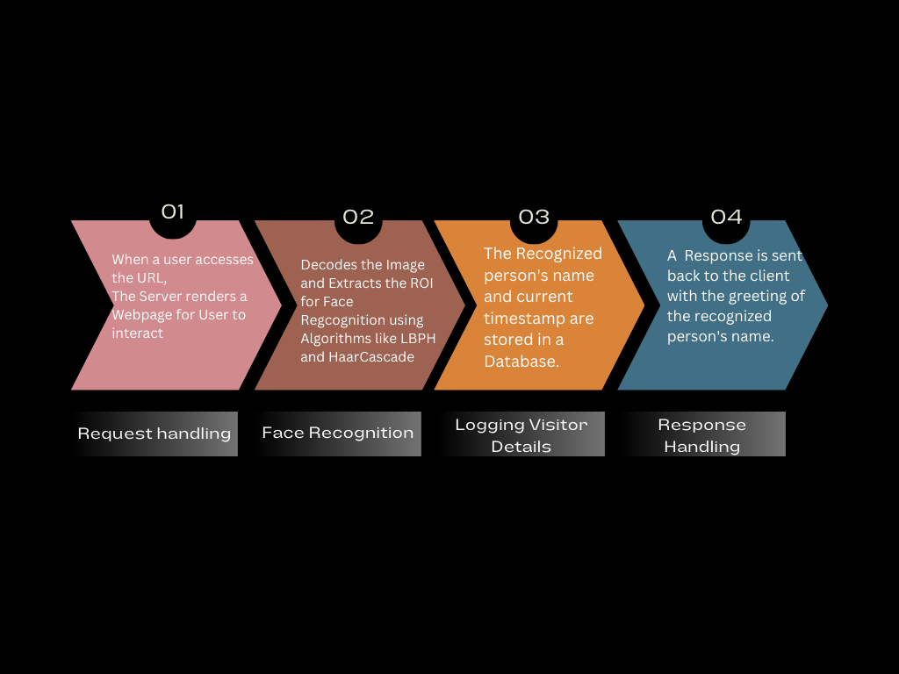
Code Workflow

Slide 11
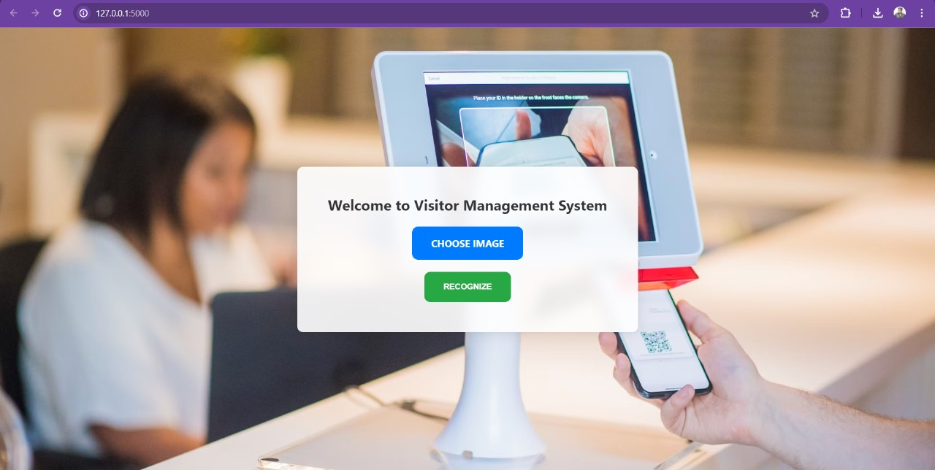
User Interface Of VMS

Slide 12
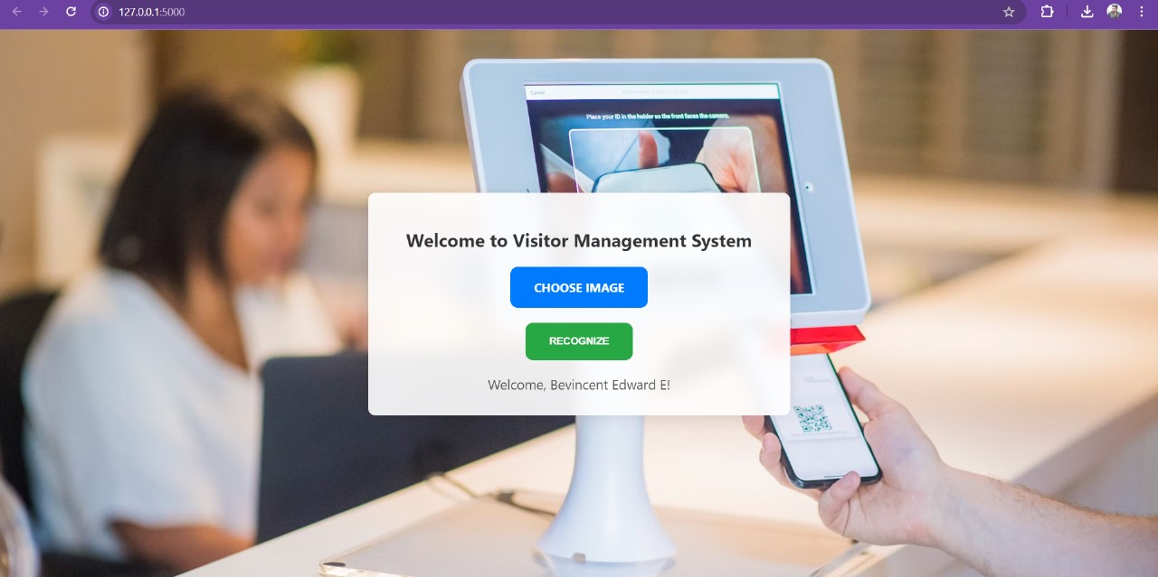

Slide 13
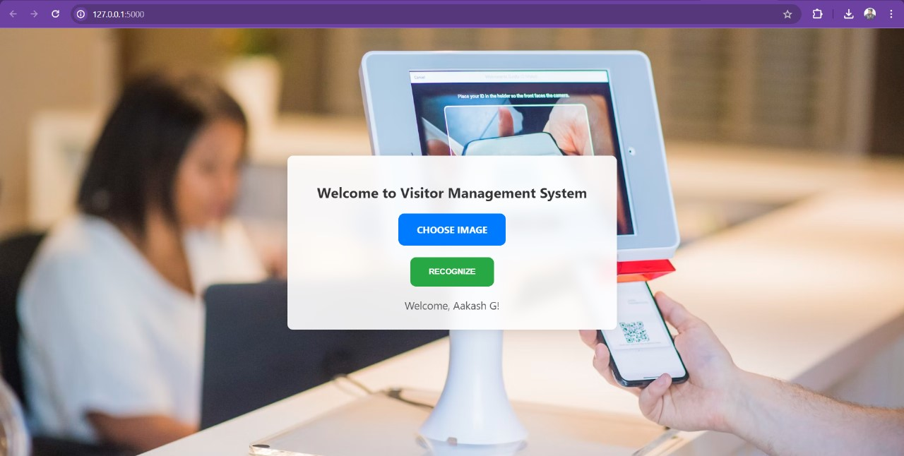

Slide 14


Slide 15


Slide 16
Conclusion
The Visitor Management System seamlessly manages visitors by leveraging face recognition technology, enabling efficient tracking and monitoring of visitor entries. With face recognition, the system accurately identifies visitors, enhancing security and streamlining the check-in process.
The integration of MongoDB ensures secure storage and easy accessibility of visitor data, facilitating future reference and analysis. This combination of face recognition and MongoDB enables organizations to maintain comprehensive visitor records while optimizing administrative processes.

Slide 17
Thank You!

